Slide 1
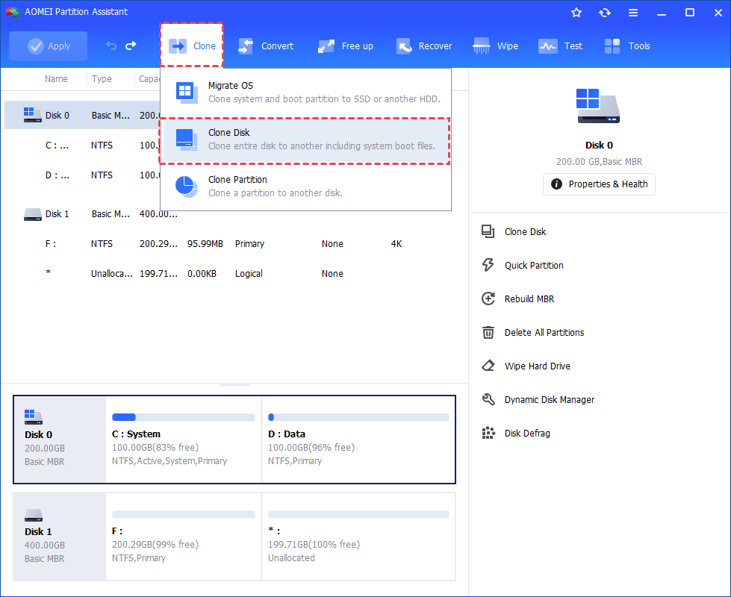
Introduction to AOMEI software
Cloning Disk with AOMEI Software

Slide 2
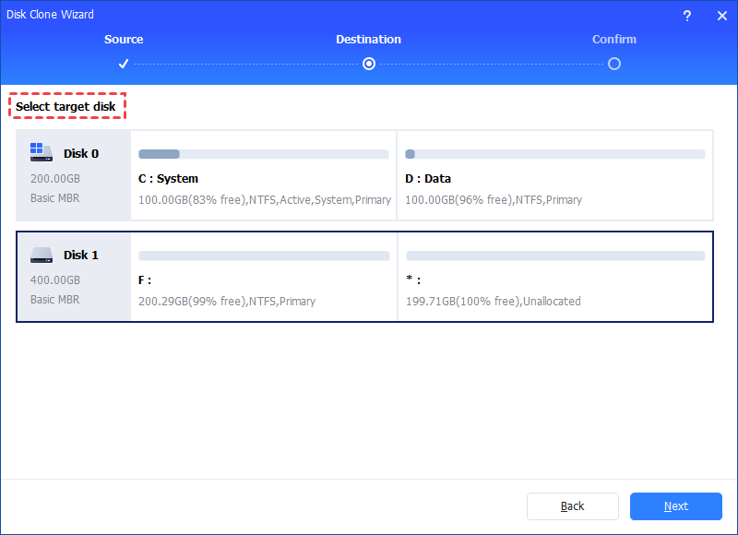
2. Choose the hard disk that you need to clone as the source disk and click "Next".
2. Choose the hard disk that you need to clone as the source disk and click "Next".

Slide 3
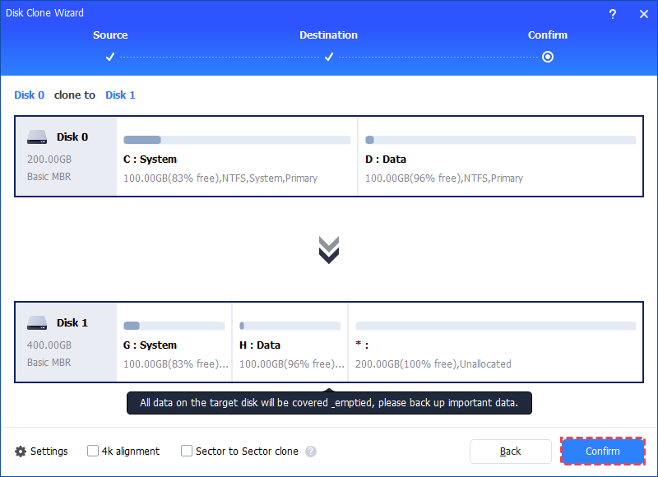
3. Select the destination disk to put the data of the source disk on, and then
3. Select the destination disk to put the data of the source disk on, and then

Slide 4
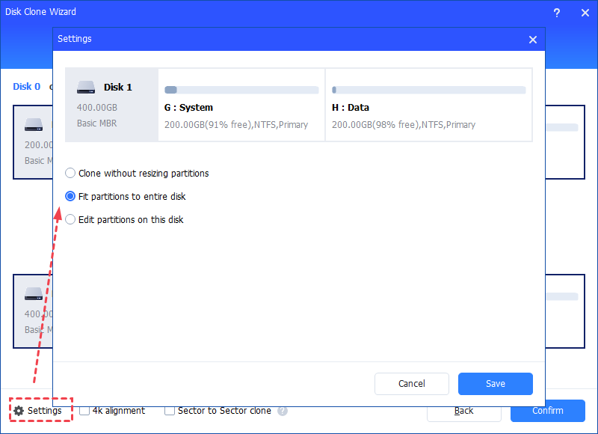
You can tick "4k alignment" to improve the reading and writing speed of SSD if the selected destination disk is an SSD storage.
You can tick "4k alignment" to improve the reading and writing speed of SSD if the selected destination disk is an SSD storage.
All data on this selected destination disk will be wiped out after you save the operation to physical disk. If there is important data on the destination drive, please make a backup in advance.
If you clone to a smaller SSD, the first option is grayed out. If you select Sector-by-Sector Clone, it is unable to adjust the size on the destination disk.
In the next window, you can click the "Settings" button to adjust the partition size on the destination disk.

Slide 5
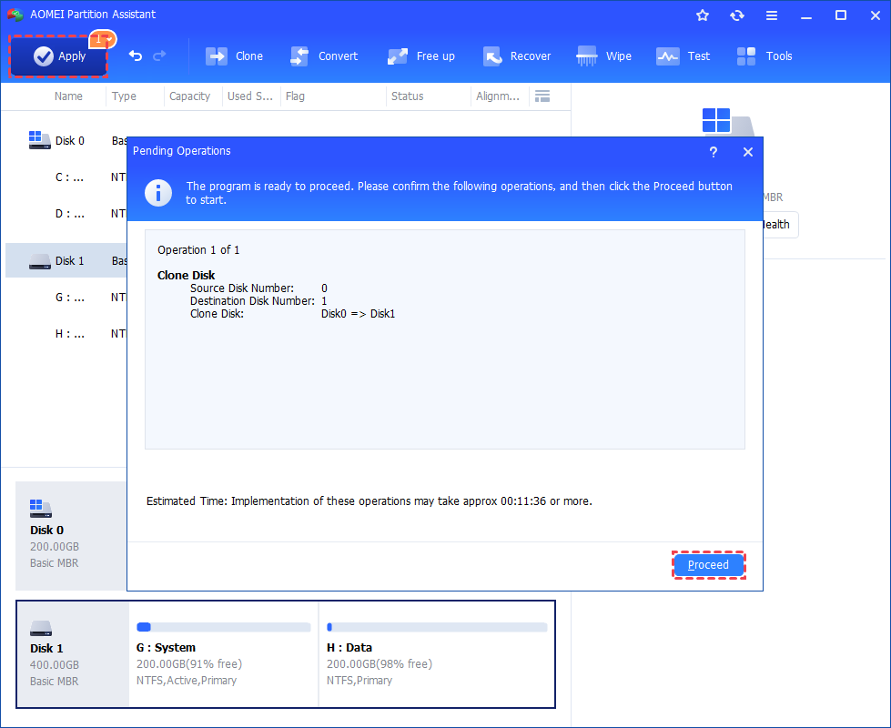
6. There are three options for you: "Clone without resizing partition", "Fit partition to entire disk" and "Edit partition on this
There are three options for you: "Clone without resizing partition", "Fit partition to entire disk" and "Edit partition on this disk". After finishing the adjustment, please click "Save".
6. You can preview the disk cloning operating by viewing the "Pending Operations". To commit the "Pending Operations", please click "Apply" and "Proceed".

Slide 6
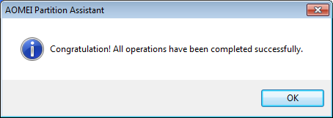
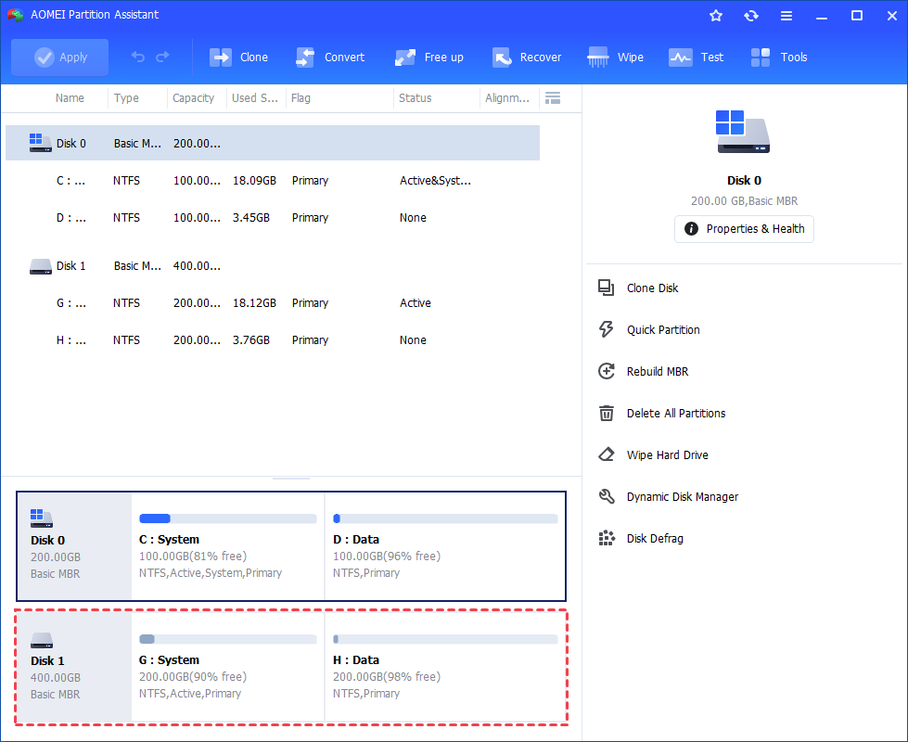
6. Once the process is completed successfully, you will get a congratulation windo
As a result, you can check the partitions layout on the destination disk will be identical to the source disk.

